Slide 1
Bumblebees as pollinators

Slide 2
Learning outcomes
I can describe pollination.
I can describe some features that make bumblebees effective pollinators.

Slide 3
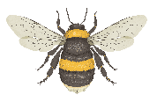

What is a pollinator?
Pollination is when pollen moves from one flower to another. Many plants need to be pollinated before they can make seeds.
A pollinator is an animal that helps make pollination happen.

Slide 4
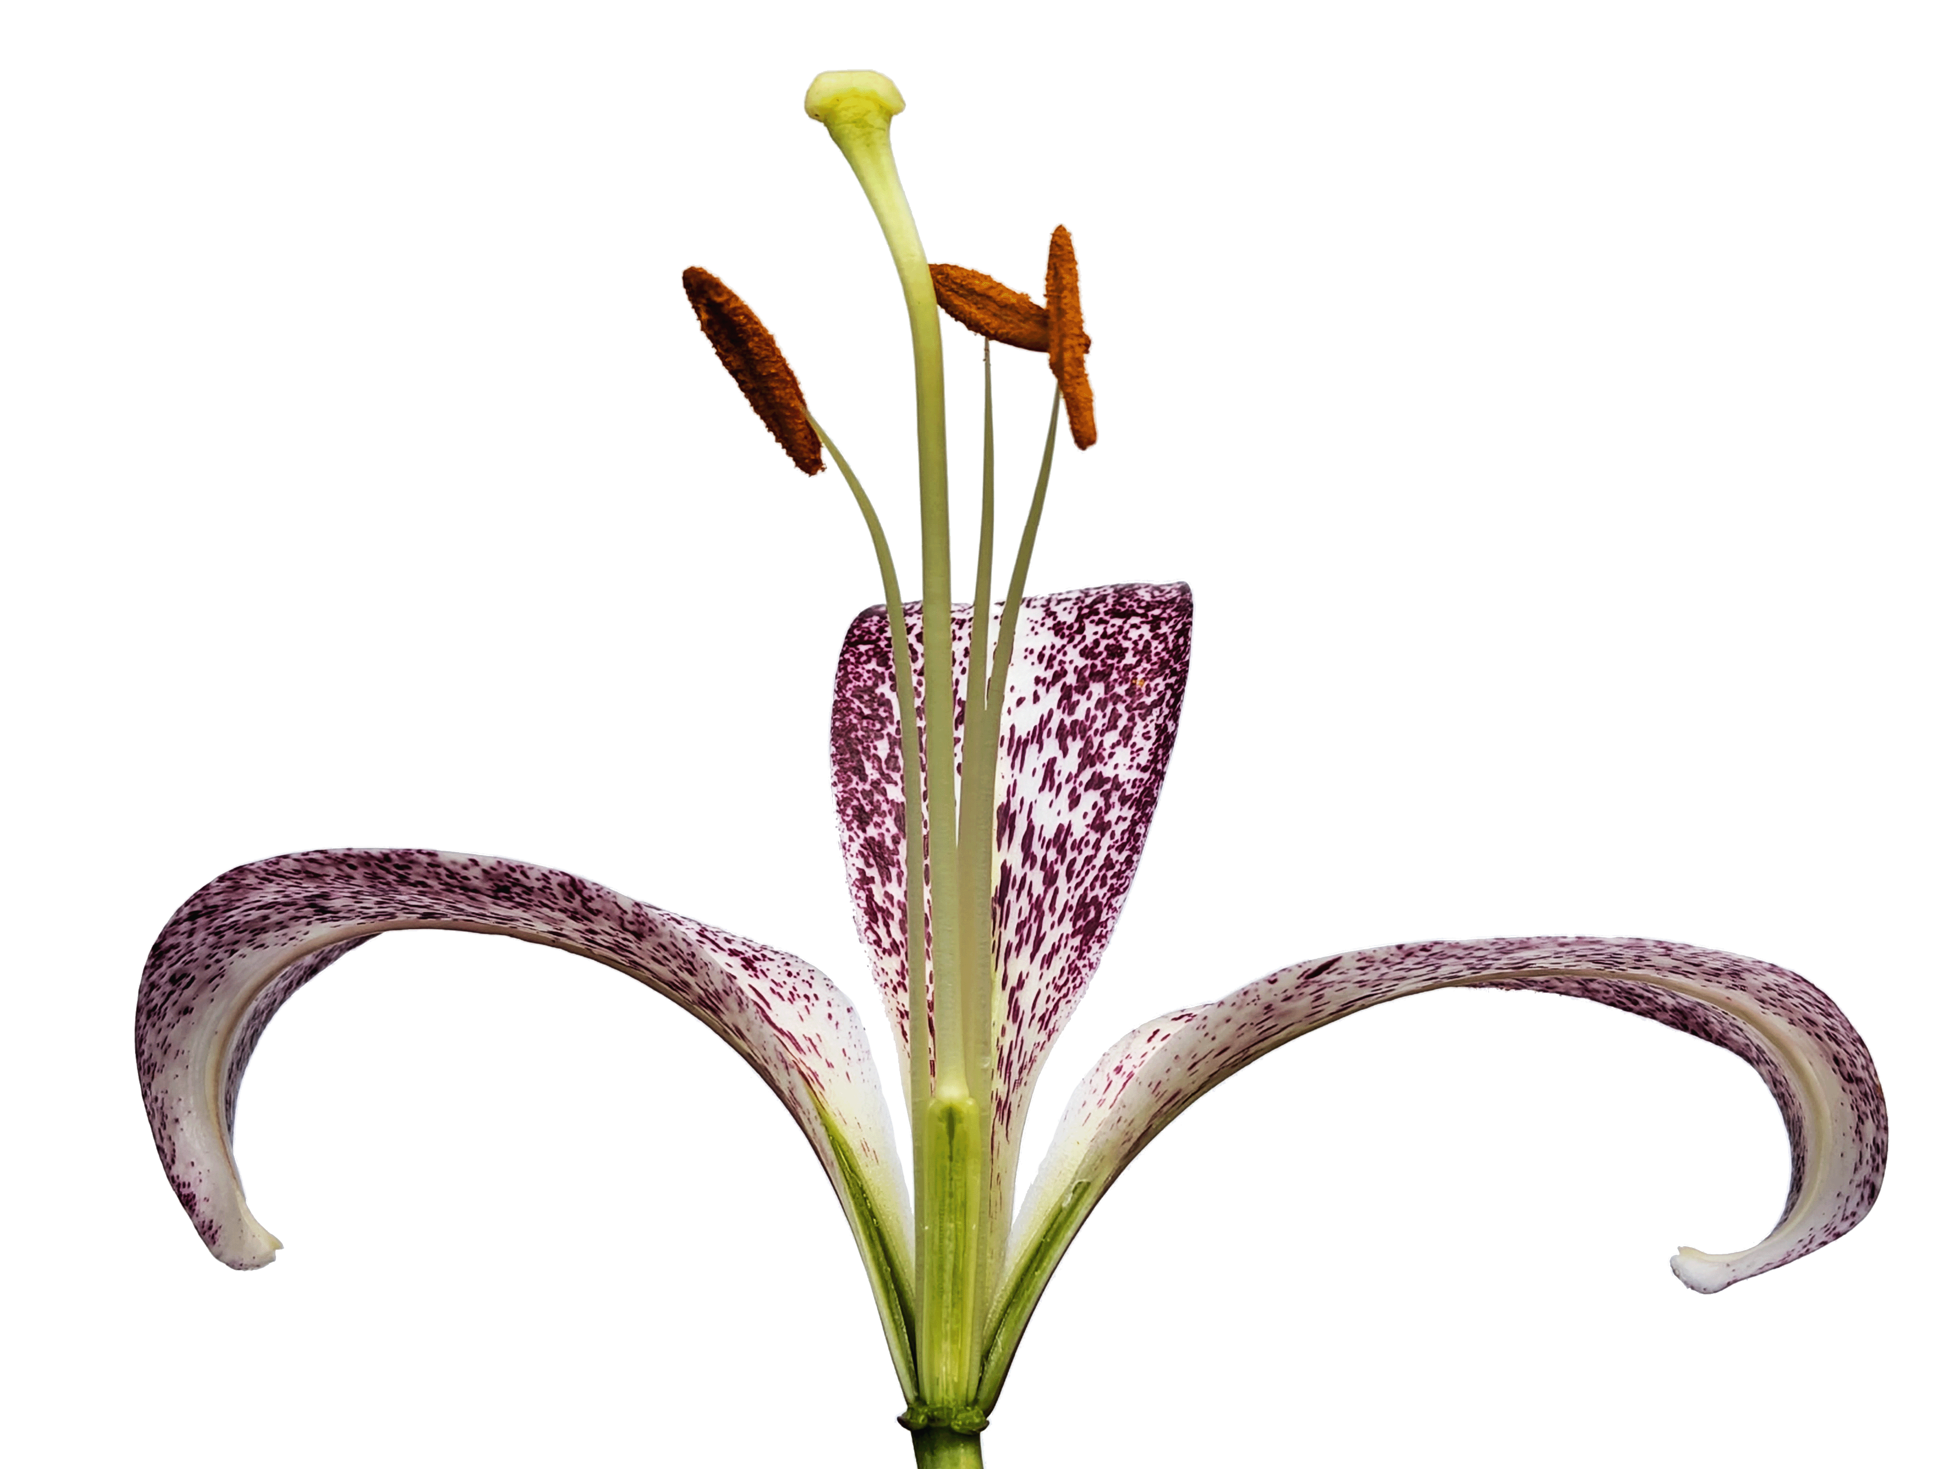
Parts of a flower
Stigma
Anther
Style
Filament
Petal
Ovary
Lily flower cross-section

Slide 5
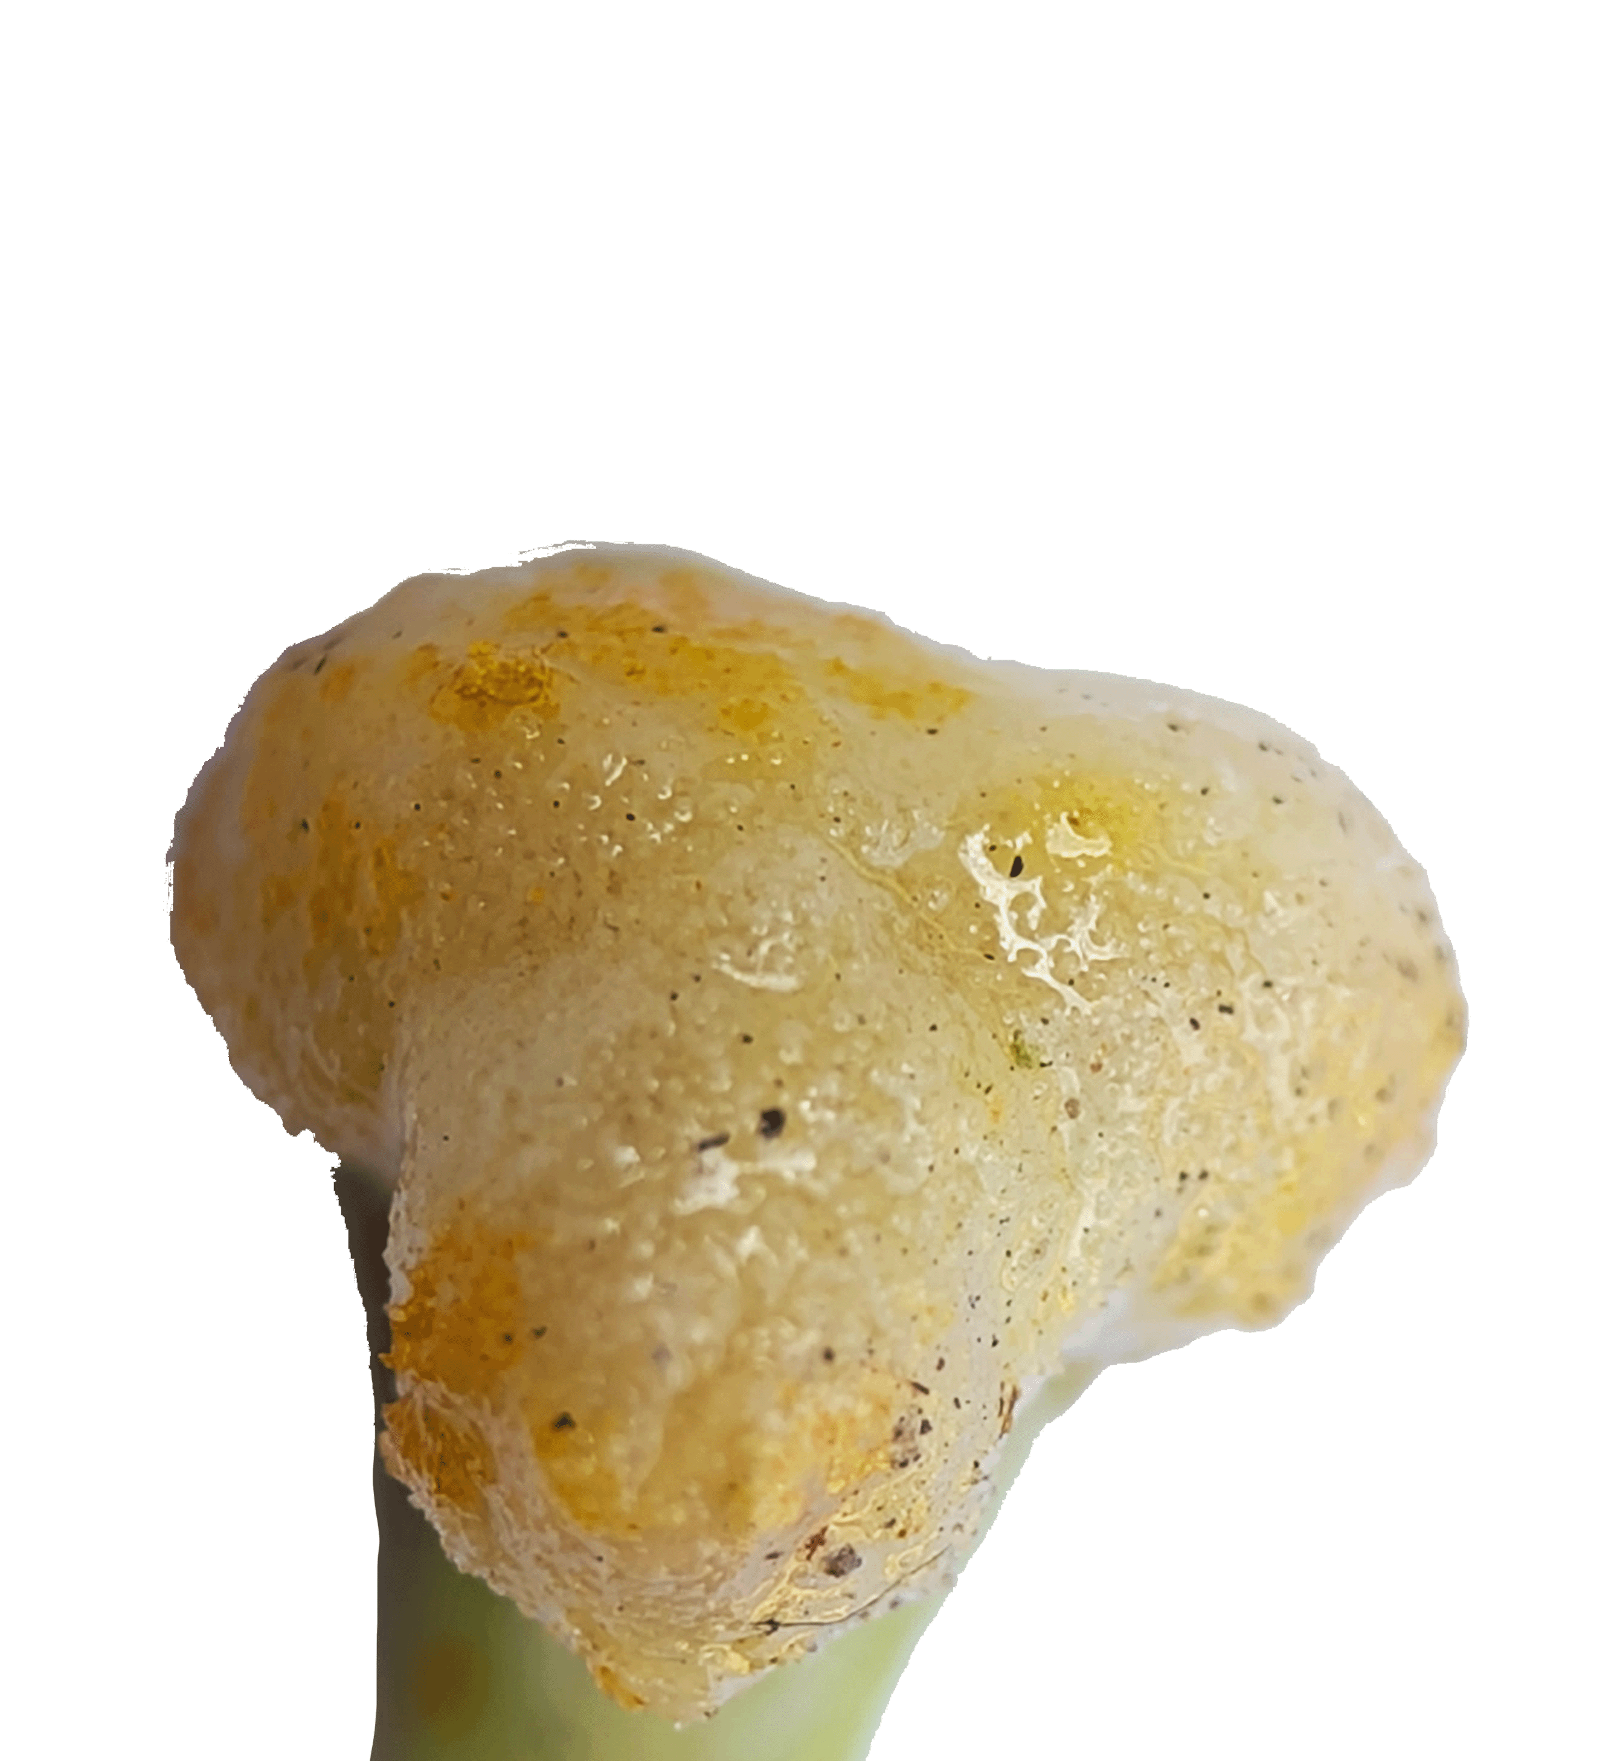
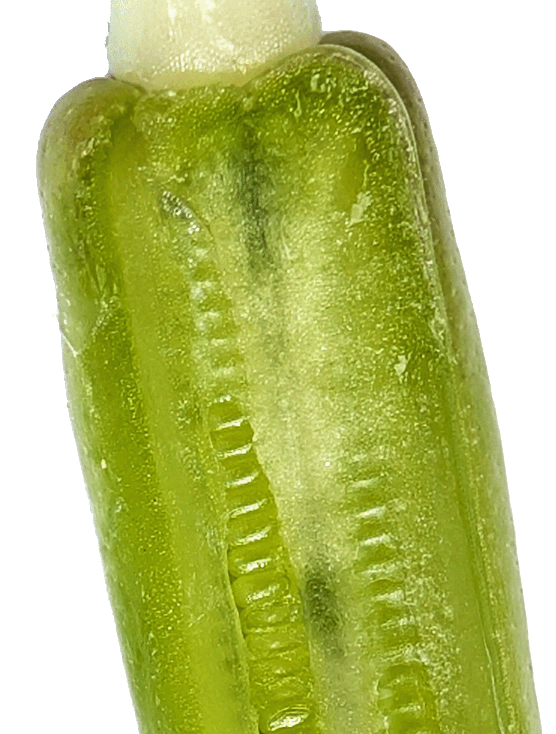
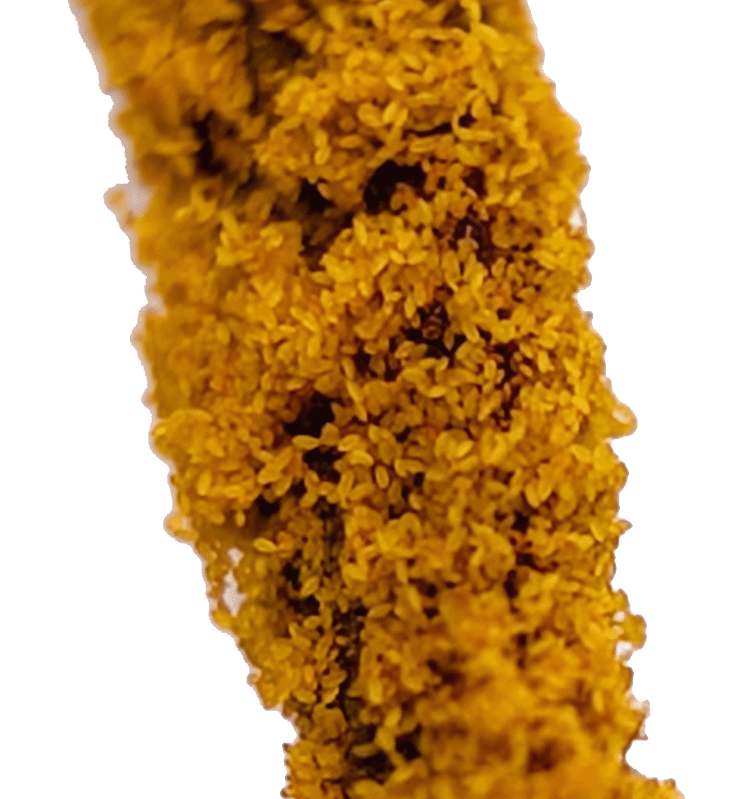
Close-ups
Stigma with pollen
Inside the ovary
Ovules
Pollen grains
Lilly flower cross-section

Slide 6
Pollination in detail
1
3
To grow into a seed, the ovules in a flower need to be fertilised.
Pollen from the same flower species lands on the stigma of a flower.
The pollen grows a tube down to the ovules.
When the tube connects to an ovule, the pollen sends a bit of DNA down the tube and fertilises the ovule
The ovule starts to turn into a seed.
2
4
Notes:
Ovules – Can be thought of as similar to eggs or baby seeds
DNA – A special molecule that acts as a recipe or instructions for how to make a living thing. Just as humans get half their DNA from each of their parents. Plants can get their DNA from 2 parent plants. Half the DNA is carried in pollen, and the other half is in the ovule.
Note that plant reproduction can be complicated.
Some plants can self-fertilize; their pollen can combine with their own ovules to produce seeds.
Sometimes plants can sometimes have extra DNA. They can have three or more sets of chromosomes, instead of 2 like most humans.

Slide 7


How pollinators help plants
Wind pollination
Wind can blow pollen between plants. But wind can blow the pollen anywhere, so most does not end up on other flowers.
When an animal visits a flower, pollen gets stuck to their body. When they go to the next flower, some of the pollen gets stuck to the stigma of the new flower.
Pollinators help plants by carrying the pollen directly from plant to plant.
Insect pollination
Notes:
Pollination by animals is more efficient than wind pollination because the animals can carry pollen directly from flower to flower.
Some animals prefer visiting certain types of flowers. This makes pollination by these specialists even more efficient. Pollination occurs only when pollen lands on a compatible plant, usually one of the same species.
For example, pollen from a daisy cannot pollinate a rose. If a pollinator prefers daisies, then they are more likely to carry pollen from a daisy to another daisy.

Slide 8
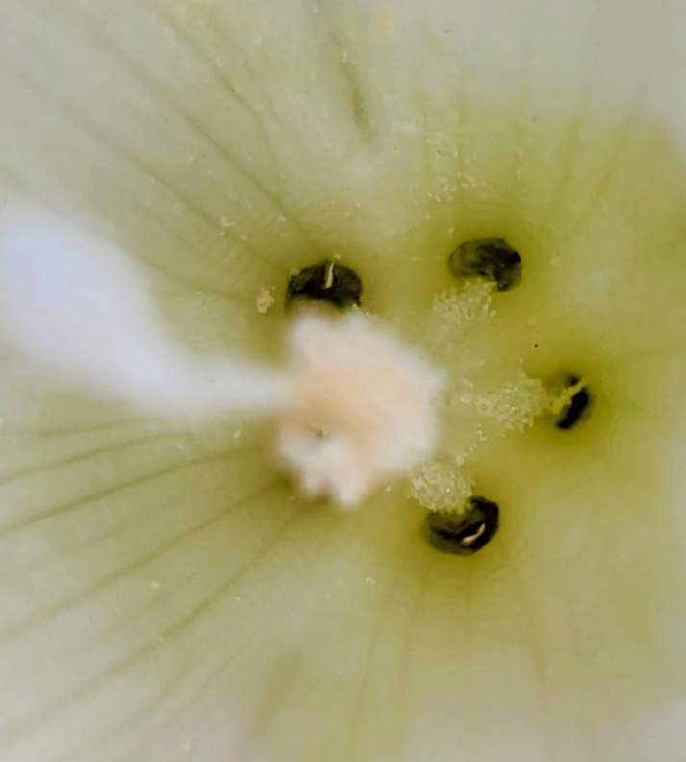
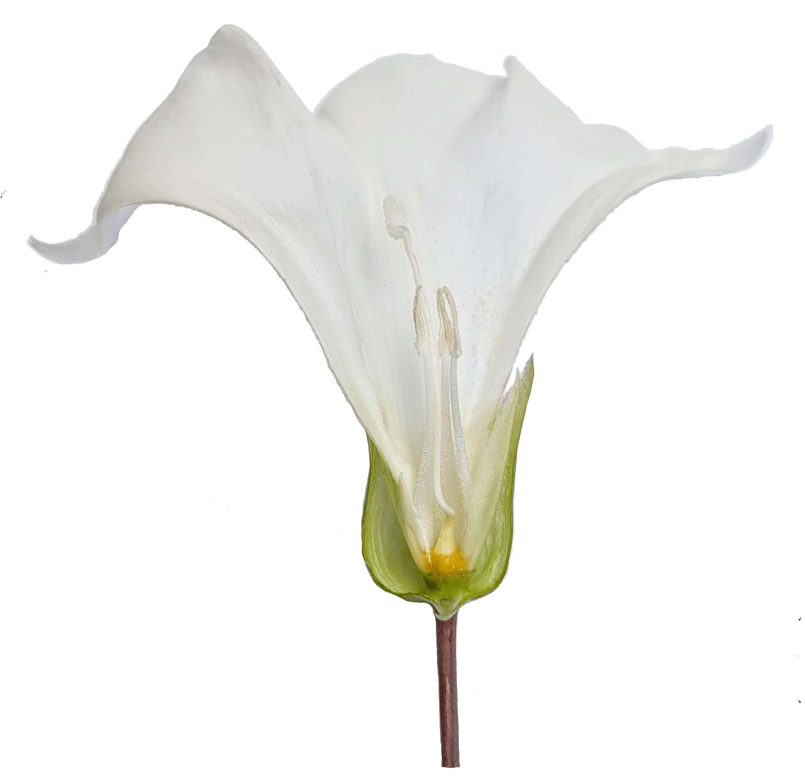
Bumblebees and flowers:
Nectar
Pollinating insects like bumblebees are often attracted to flowers by the nectar they produce.
Nectar is full of sugar and is a good source of energy for bumblebees.
Honeybees and bumblebees turn nectar into honey.
Nectar
Bindweed flower cross-section

Slide 9
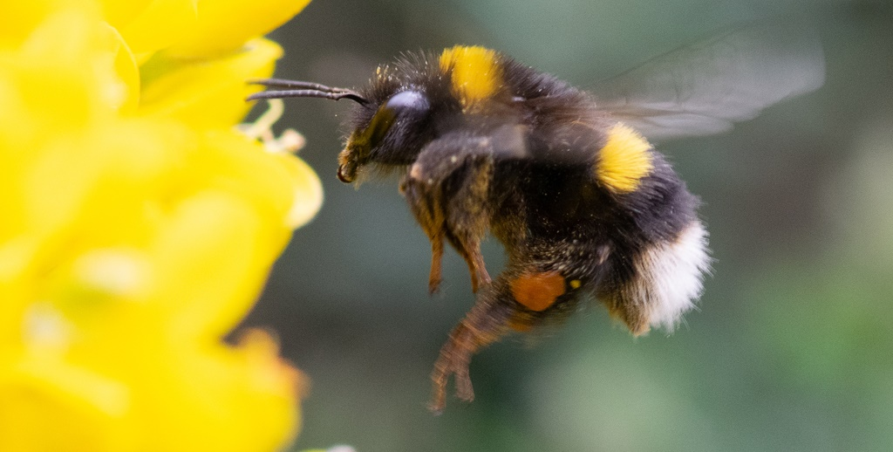
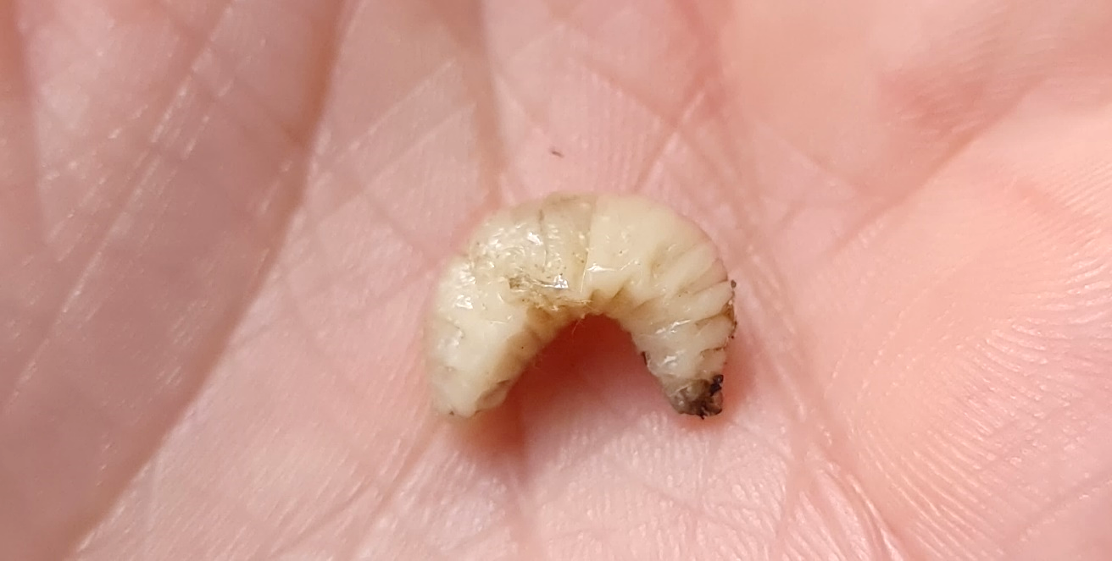
Bumblebees and flowers:
Pollen
Bumblebees and other bees collect pollen from the flowers to feed their larvae (baby bees).
Pollen is full of protein and other nutrients. Larvae need protein to grow.
Bumblebee collecting pollen
Bumblebee larva on a person’s hand
Image from iNaturalist. CC0
Notes:
See the Bumblebee lifecycle resource for more information about bumblebee life stages.

Slide 10
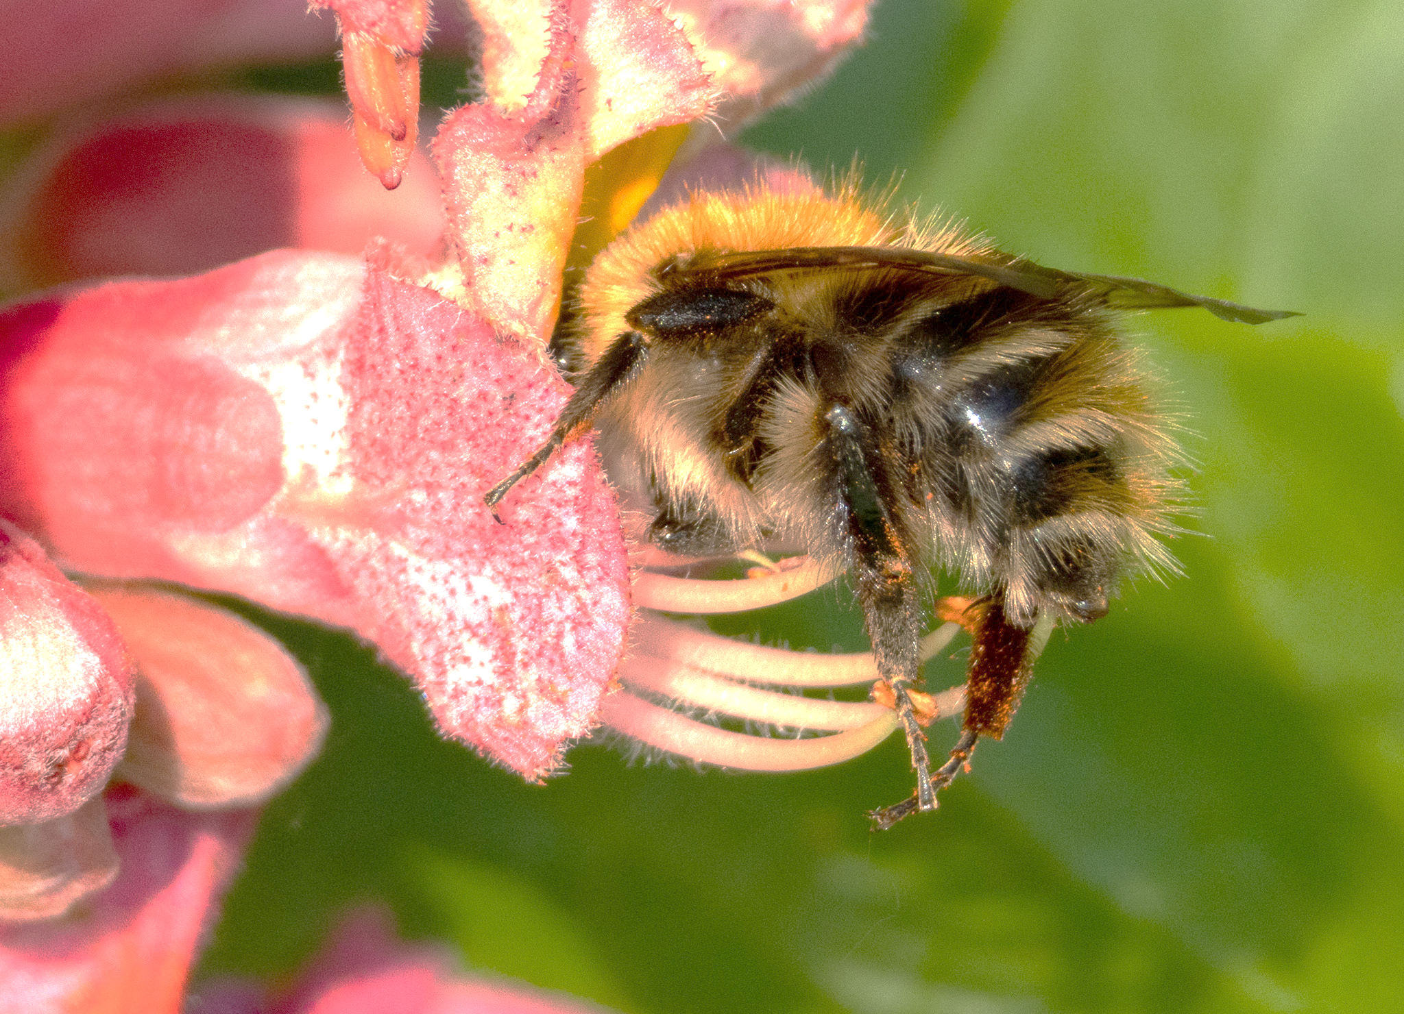
Collecting pollen
Bumblebees and honeybees have special long hairs on their legs which form a pollen basket.
Bumblebees comb themselves to keep clean and to collect the pollen stuck to their bodies. They scrape this pollen into their pollen baskets.

Slide 11
Collecting pollen
Pollen grains
Pollen basket

Slide 12
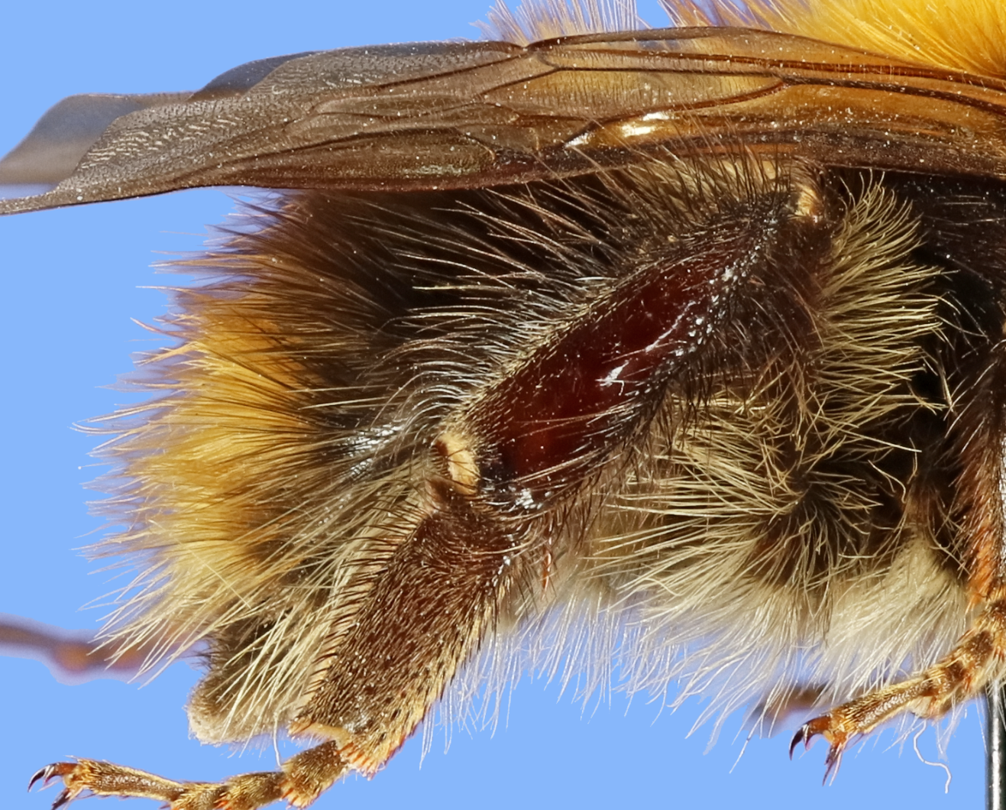
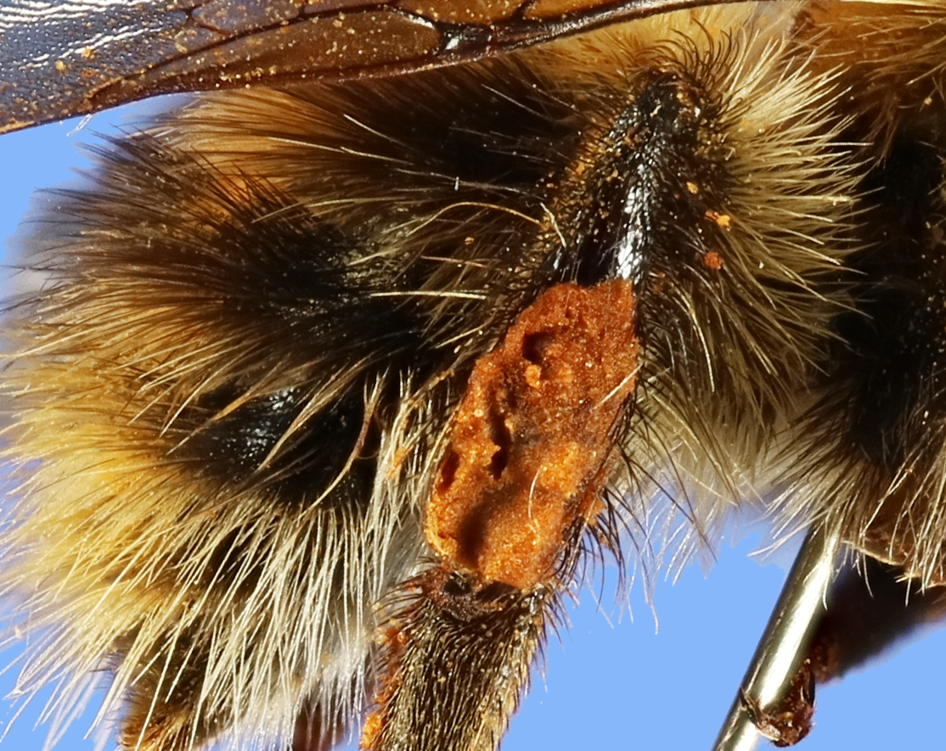
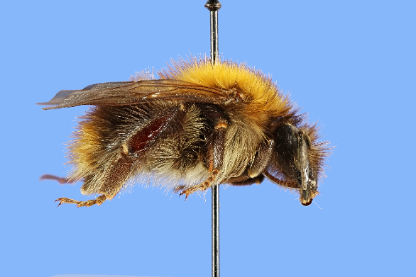
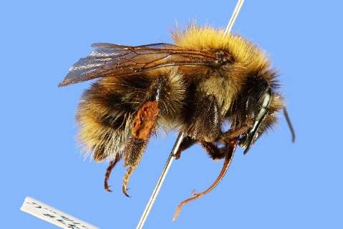
Pollen basket photos
Pollen basket with pollen
Pollen basket

Slide 13
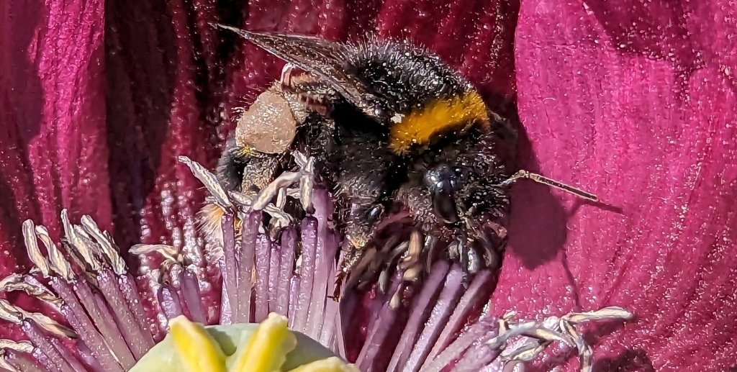
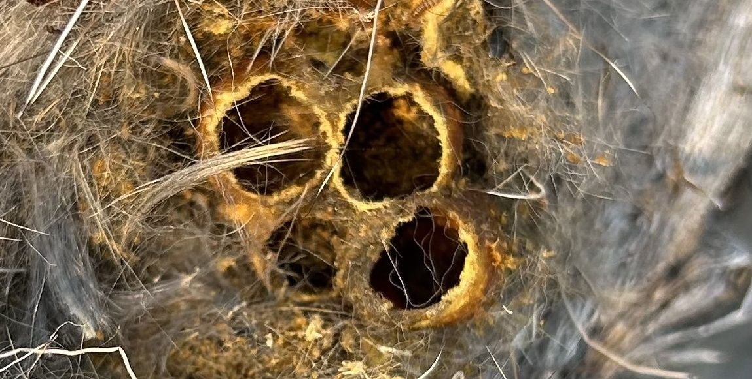
What do bees do with pollen?
When bees and bumblebees go back to the colony, they drop these pollen balls into chambers together with an egg.
When the eggs hatch the larvae (baby bees) have plenty of pollen to eat.
Pollen ball
Bumblebee egg chambers

Slide 14
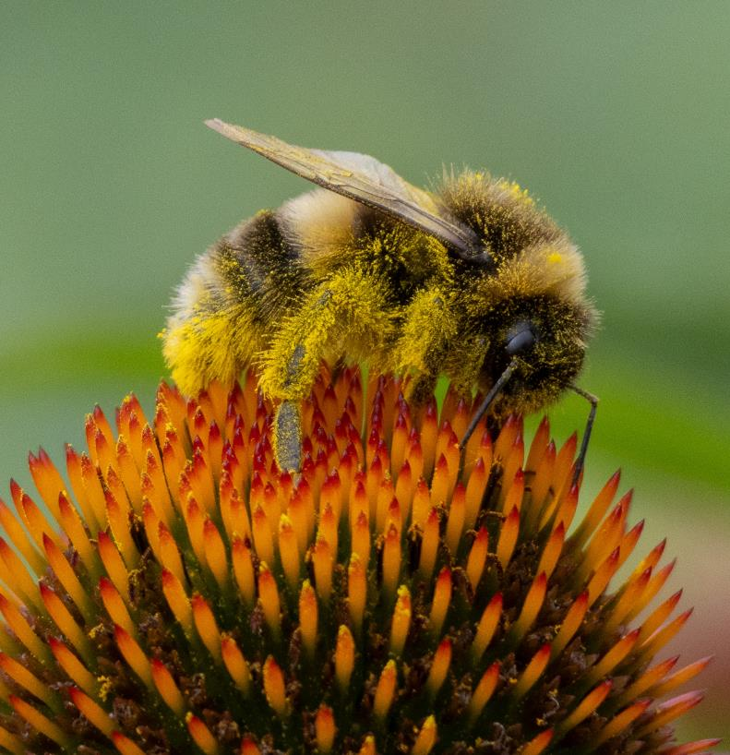
Why are bumblebees effective pollinators?
Flowers and bumblebees have opposite static charges. This means pollen is attracted to bumblebees and gets stuck to them.
Their thick fur means a lot of pollen can stick to them.
Bumblebee covered in pollen

Slide 15
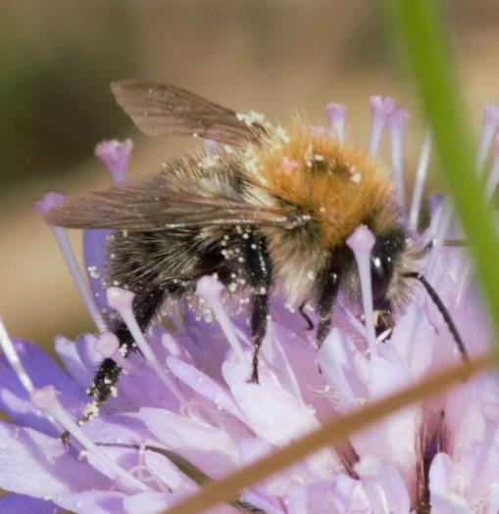
It can be hard for bumblebees to clean all the pollen from their fur and gather it in their pollen baskets.
When a bumblebee visits another flower, it is easy for some pollen to get attached to the sticky stigma.
Bumblebee with pollen walking between flower stigmas

Slide 16
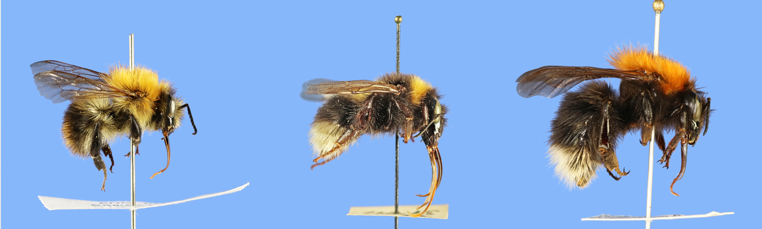
Challenge question
How many differences can you spot that might affect how these bumblebees pollinate?
Notes:
A few possible responses
Their tongues are different lengths. Bumblebees with longer tongues can reach nectar in longer-shaped flowers.
Some are furrier than others. This might affect how much pollen they carry.
Their bodies are different shapes. This might affect the flowers they can fit inside.
They are different sizes. Bumblebees are bigger and heavier than many other insect pollinators. This lets them access the pollen and nectar in some flower shapes more easily. For example, pea flowers have petals that are pressed together. When a bumblebee lands on one of these flowers, it is heavy enough to push down the petals and get inside.

Slide 17
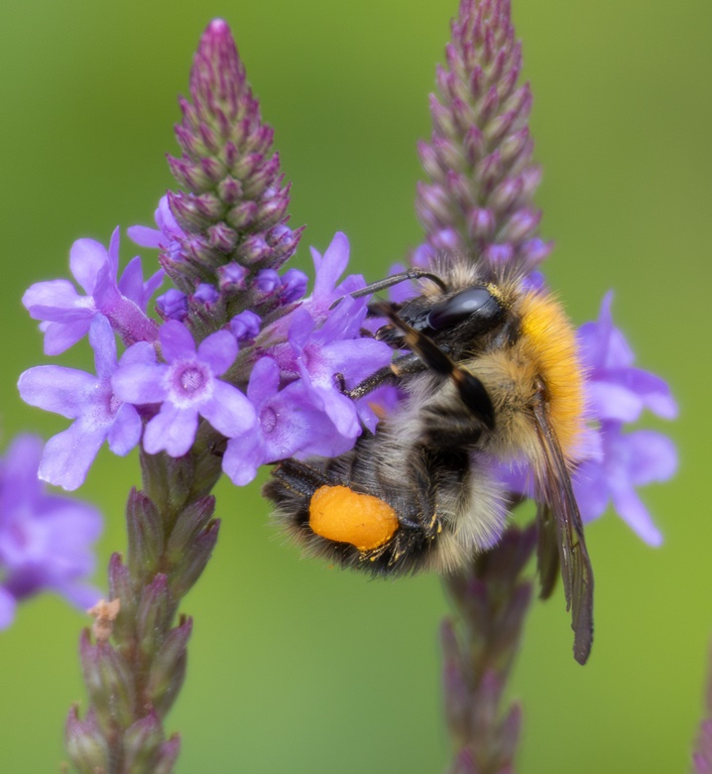
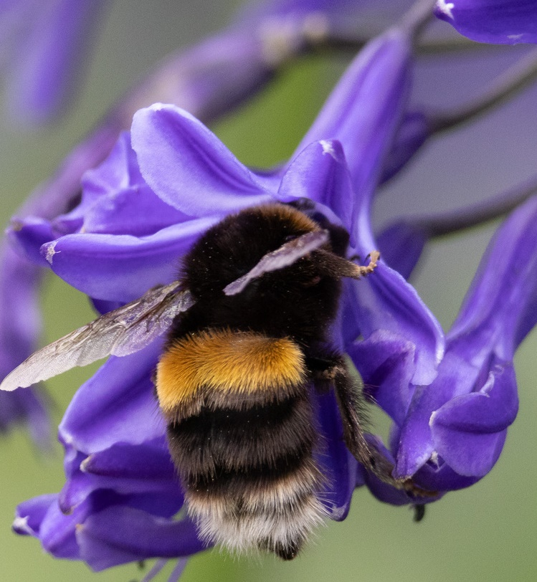
There are around 24 species of bumblebee in the UK. Some of them prefer to visit certain types of flowers. For example, bumblebees with long tongues can get nectar from long flowers more easily.
This makes bumblebee pollination even more efficient for plants because it is more likely that pollen gets moved to a matching plant.
Bumblebee visiting small flowers.
Bumblebee visiting a long flower.

